Slide 1



Forecasting Airbnb Prices in Cambridge, Massachusetts: “Regression Analysis”
Present by: Twinkle Patel & Yasika Sawant
Course: ECON 6430 Business Forecasting
Instructor: William J. Smith
Date: 12/08/2024

Slide 2

Introduction
Literature Review
Dataset & Methodology
Data Description
Result
Summary Statistics
Conclusion
SAS Code

Slide 3

Introduction :
This study explores the factors that influence the pricing of Airbnb listings in Cambridge, Massachusetts. Through regression analysis, we identify key variables that significantly impact pricing, including room type, minimum nights, room availability, host reviews, number of host listings, and neighborhood characteristics.
This result will help us understand how different factors affect Airbnb listing prices. It will highlight which factors are most important based on statistical measures like R-squared values and t-statistics, showing how well the data explains price variations.

Slide 4

Literature Review :
1. Factors Affecting Airbnb Listing Prices: Evidence from U.S. Cities
Key Findings: Entire homes command higher prices compared to private or shared rooms. Location is a significant determinant of pricing.
Reference: Wang, D., & Nicolau, J. L. (2017). Price determinants of sharing economy-based accommodation. Tourism Management, 62, 278-287.
2. The Impact of Reviews and Ratings on Airbnb Pricing Strategies
Key Findings: A higher number of reviews and better ratings positively influence prices. Reviews indicate host reputation and listing activity.
Reference: Xie, K. L., & Mao, Z. E. (2017). The impacts of user-generated content on room sales and pricing strategies: Evidence from Airbnb. International Journal of Hospitality Management, 67, 15-25.
3. Geospatial Analysis of Airbnb Rentals and Their Prices
Key Findings: Proximity to attractions and geographical accessibility, such as longitude and latitude, are critical factors in determining rental prices.
Reference: Gutiérrez, J., et al. (2017). The structure of Airbnb pricing: Geospatial analysis in European cities. Current Issues in Tourism, 20(7), 763-770.

Slide 5
Dataset & Methodology :
Dataset:
Airbnb listings data from Cambridge, Massachusetts. (https://insideairbnb.com)
The data covers the period from July 2023 to June 2024
Methodology:
Ordinary Least Squares (OLS) Regression was performed to analyze the relationship between listing prices (dependent variable) and several independent variables.
Both continuous and categorical variables were included in the regression model, allowing for a comprehensive analysis of their individual effects on pricing.
Dummy variables were created for categorical variables, enabling their inclusion in the regression analysis.

Slide 6

Data Description :
Dependent Variable: Price
Independent Variables(10):
minimum_nights: The minimum number of nights required for booking a listing.
number_of_reviews: The total number of reviews received by a listing.
availability_365: The number of days a listing is available in a year.
reviews_per_month: The average number of reviews received per month.
longitude: The geographical longitude of the listing.
last_review: The number of days since the last review was written.
calculated_host_listings_count: The number of listings managed by the host.
number_of_reviews_ltm: The number of reviews received in the last 12 months
room_type Dummy Variables: entire_home, private_room, shared_room
Neighbourhood Dummy Variables : West_Cambridge East_Cambridge Agassiz Mid_Cambridge North_Cambridge Riverside The_Port Cambridgeport Neighborhood_Nine Cambridge_Highlands
Price
minimum_nights
number_of_reviews
availability_365
reviews_per_month
last_review
calculated_host_listings_count
number_of_reviews_ltm
Room_type
neighbourhood
longitude

Slide 7
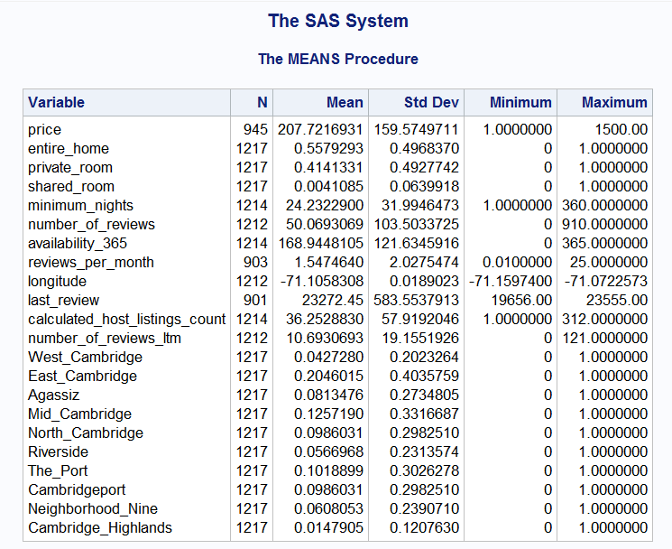

Summary Statistics :

Slide 8
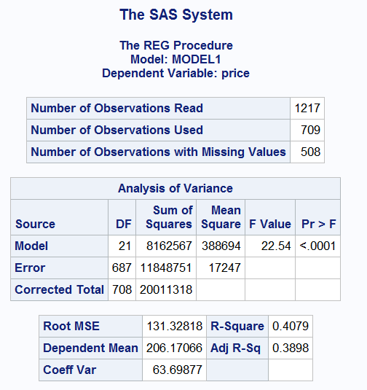
Results: :
The R² indicates that approximately 38.98% of the variation in the dependent variable (price) can be explained by the independent variables in the model.
A p-value less than 0.05 means the model is statistically significant overall. It indicates that the independent variables, as a group, significantly predict the dependent variable (price).

Slide 9
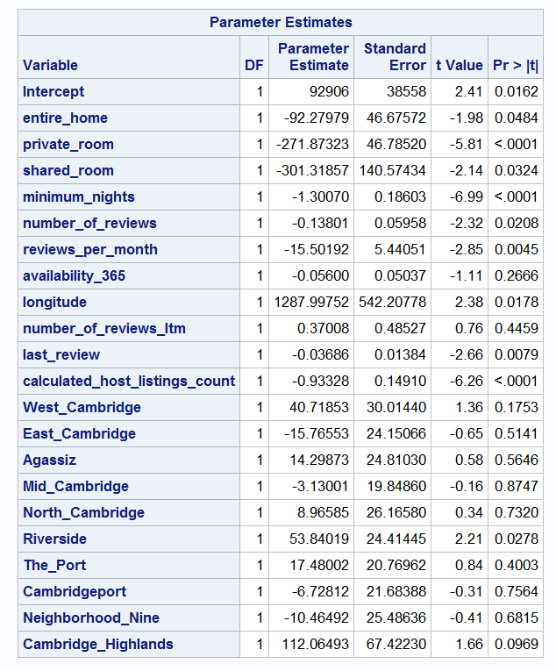
Interpretation of Results: :
The negative coefficients for "private_room" and "shared_room" suggest that these room types are associated with lower prices compared to "entire_home.“
"Minimum_nights" has a negative effect on price, indicating that listings with more minimum nights tend to have lower prices.
"Reviews_per_month" and "number_of_reviews" are also negatively associated with price, suggesting that higher review activity might correlate with lower prices.
"Longitude" shows a positive association with price, indicating that location impacts pricing significantly.
Among neighborhoods, "Riverside" has a positive impact on price, while others like "East Cambridge" and "Mid Cambridge" show no significant influence.

Slide 10








Conclusion :
Key Findings:
Room type, minimum nights, number of reviews, and reviews per month, longitude, last review, calculated host listing count, Riverside significantly influence the price of Airbnb listings.
Implications:
The study highlights the importance of listing characteristics in determining pricing strategies for Airbnb hosts, suggesting that adjusting room types and managing reviews can influence competitiveness.
Listings with fewer minimum nights and higher numbers of reviews tend to have lower prices, likely reflecting more accessible or affordable options.
The results confirm and extend findings from previous literature, such as the impact of room type on pricing (Zervas et al., 2017).

Slide 11
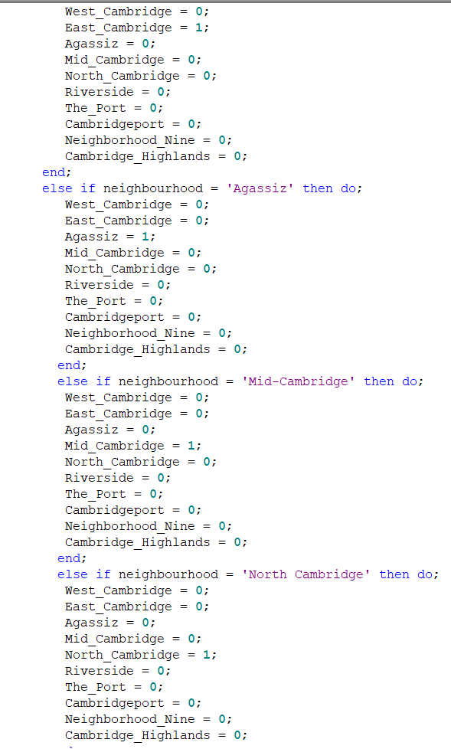
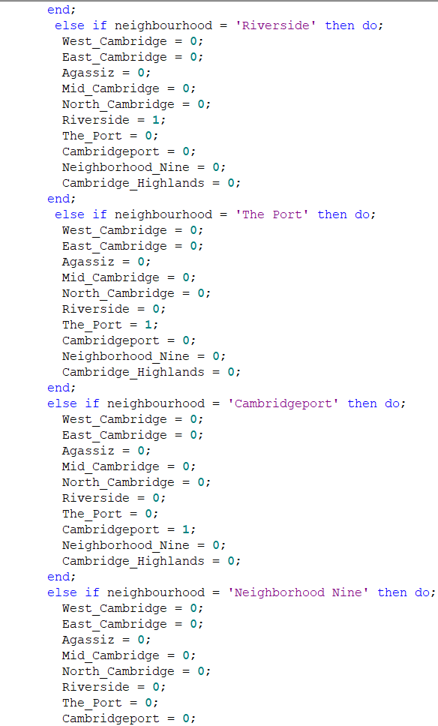
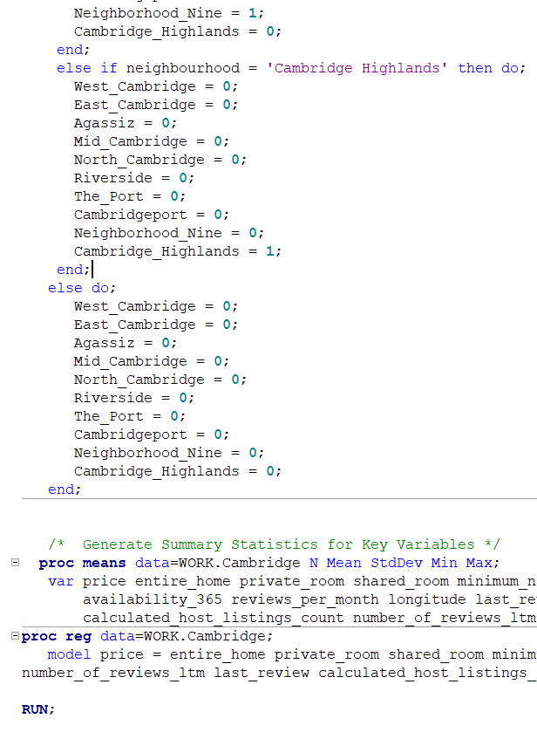
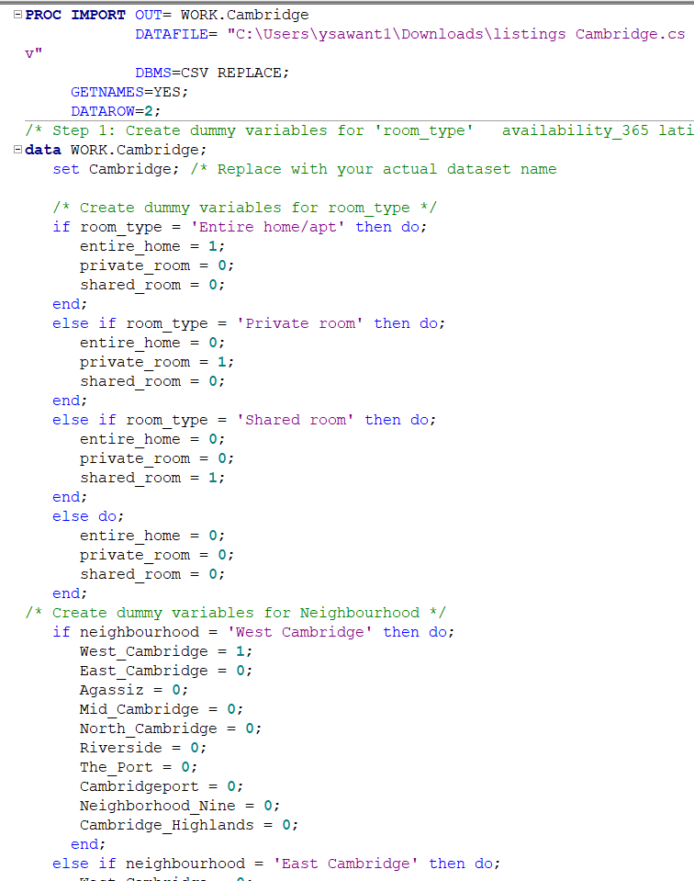
SAS Code :

Slide 12

Thank you!

